Slide 1

Screening of eyelid
retraction and
overshooting of eyes
Team ​Eye-Fi
Kevin | Shivakshit | Mehal | Saurabh​

Slide 2
Duane Retraction Syndrome(DRS)
Congenital eye movement anomaly characterized by variable horizontal duction deficits, with narrowing of the palpebral fissure and globe retraction on attempted adduction, occasionally accompanied by upshoot or down-shoot.

Slide 3
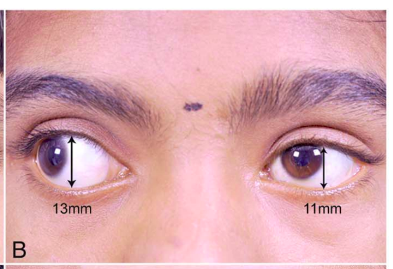
Eyelid Retraction
Exposure of the sclera above or below the limbus due to the displacement of the upper or lower eyelid.

Slide 4
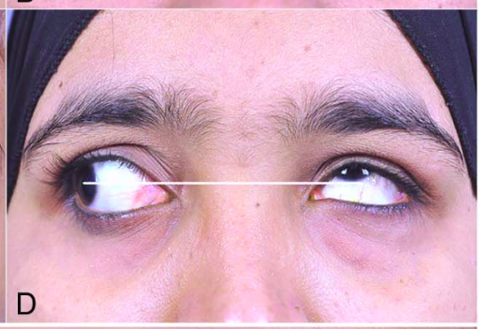
Overshooting of the eyes
It is a lack of coordination of movement typified by the undershoot or overshoot of intended position with the eye.

Slide 5
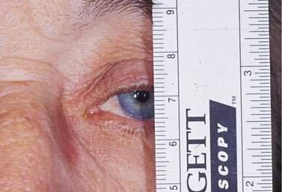
Current Method
Complete detection Method is done Manually.
Scale is used to measure distances.
Manual measurement on pictures.

Slide 6
Problems
Detection of these Disease is a manual process.​
Experienced Clinicians required​.
Lack of access to expert doctors in rural parts of India​.
Monitoring during treatment is manual and thus difficult.​​

Slide 7
But..
solution
We have a

Slide 8
Eye-Fi

Slide 9
JUST
2 STEPS
1 Click Picture
2 Get the Report

Slide 11
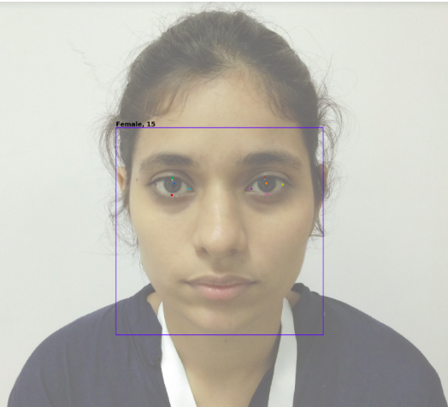

Slide 12
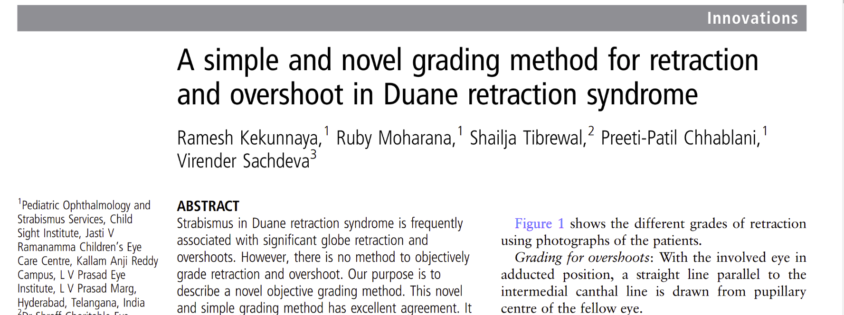
Reference::

Slide 13
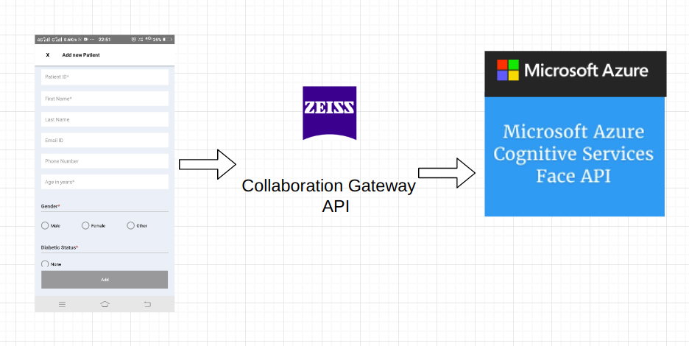
How stuff works...
Image Transfer
Our algorithm uses Face API for feature extraction
Mobile app/Website

Slide 14
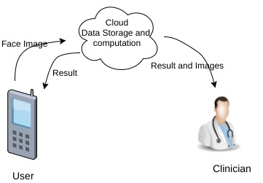
Data Flow

Slide 15
Scaling & Impact
As the cost of APIs are low, Eye-fi is affordable to common public.
Approximately- 1312 specialty eye hospitals and 164 optometry institutes in India.[India Vision Institute report]
Eye-Fi can be used by the specialists in these institutes thus reducing their load.
Application is so simple, that even common people can use it to monitor and detect DRS.

Slide 16
Challenges
Cases of DRS type 1, 2 and 3 can be detected with high precision but in other cases, efficiency got reduced due to insufficient data.

Slide 17
Future Work
Improving working algorithms and increasing accuracy
Measurement in real time videos
User feedback system
scaled to all grades of overshooting in accordance of the method proposed by Dr.Kekunnaya et al.
extended for data collection for future research

Slide 18

Thank You

